Slide 1
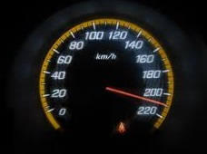

Tools for Performance, Load Testing, Stress Testing Using Telerik Test Studio
Pavel Pankov
QA Lead
Automated Testing Team
Telerik QA Academy

Slide 2

Table of Contents
Performance and Load Testing Using Test Studio

Slide 3




Test Studio
Performance and Load Testing
http://www.telerik.com/automated-testing-tools/support/documentation/user-guide

Slide 4
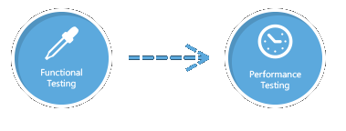
Performance Testing
Run an existing functional test as a performance test
Select the appropriate functional test
No or minimum validations
No used variables in the test
http://www.telerik.com/automated-testing-tools/support/documentation/user-guide/performance.aspx

Slide 5
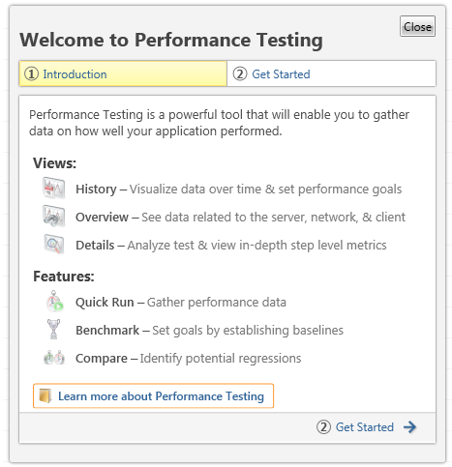
How to?
The Performance Tab
Introduction
Views
Features

Slide 6
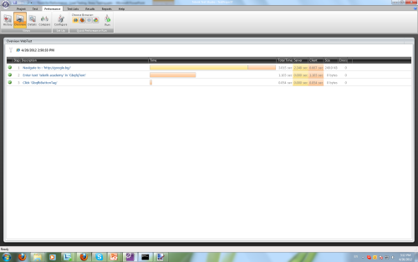
Views
History
Shows all recent Performance Runs listed in rows and the duration of the test itself
Overview
Each step of the Performance Run is listed as a row in a grid with indicators:
Total Time
Server Time
Client Time
Size

Slide 7
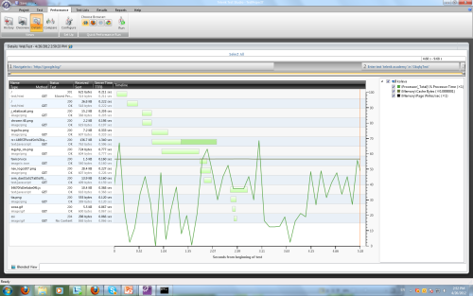
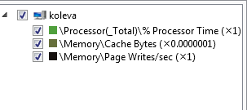
Views(2)
Details
the requests made from the server
how long the requests take
the bandwidth used
Legend with the Performance Counters is shown to the right
Test steps are shown as blocks in the top horizontal bar

Slide 8
Features
Quick Run
A fast way to start your Performance Run, applying the last settings used
Benchmark
Choose the Run that you want to use as a base to compare
Compare
Comparison between two Performance Runs

Slide 9
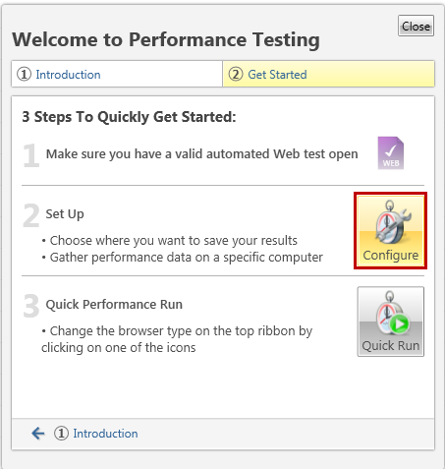
How To?
Performance Test Configuration
Getting started
Configure
Quick Run

Slide 10
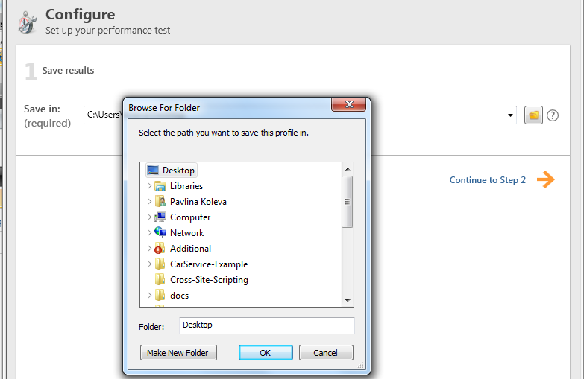
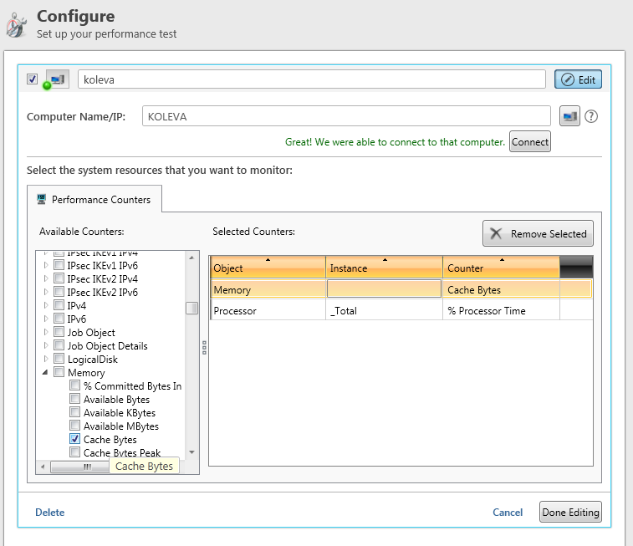
Configuring Performance Test Settings
Configure where the results will be saved
Select a computer to track it’s performance
Select Counters to be monitored

Slide 11
Performance Testing with Test Studio
Demo

Slide 12
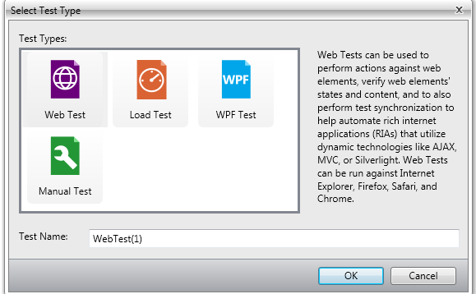
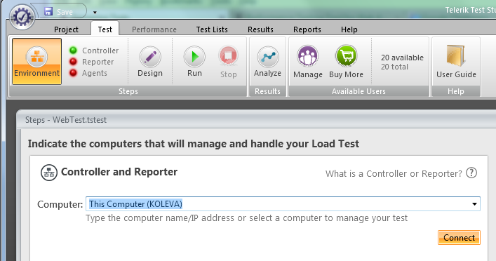
Load Testing
Create New Load Test
Configure your Test Machine
Select the machine you’ll use to perform the load test
http://www.telerik.com/automated-testing-tools/support/documentation/user-guide/load-testing.aspx

Slide 13
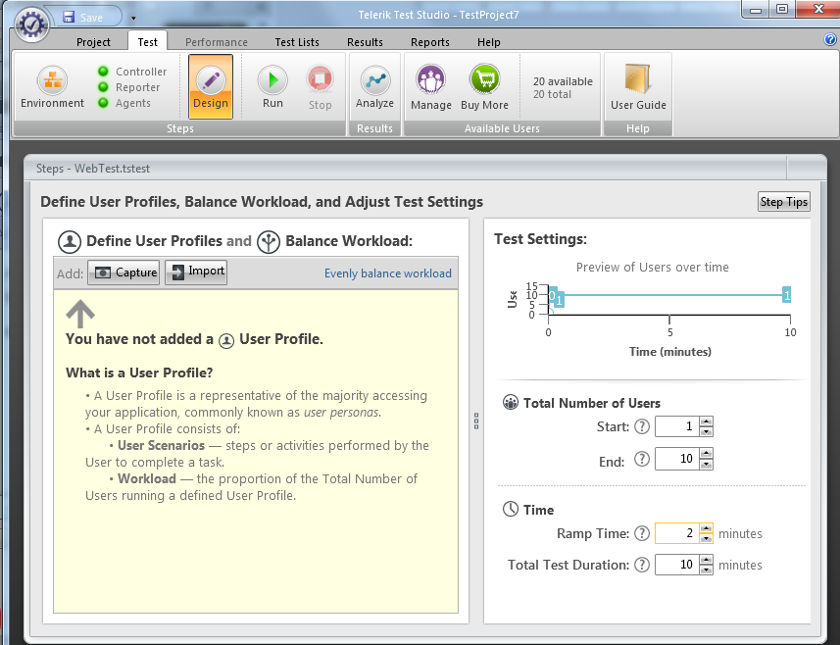
Design Your Load Tests
Capture HTTP traffic
From Existing web test
New
Test Settings
Total number of users
Time

Slide 14
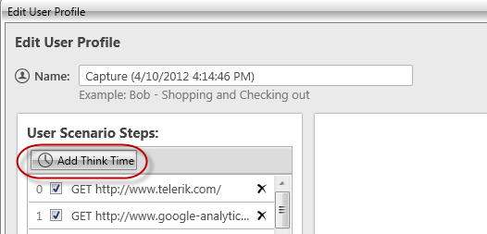
Design Your Load Tests(2)
Dynamic Targets
unique parameter or variable used by the application to generate information like a unique user ID or session ID
Think Times

Slide 15
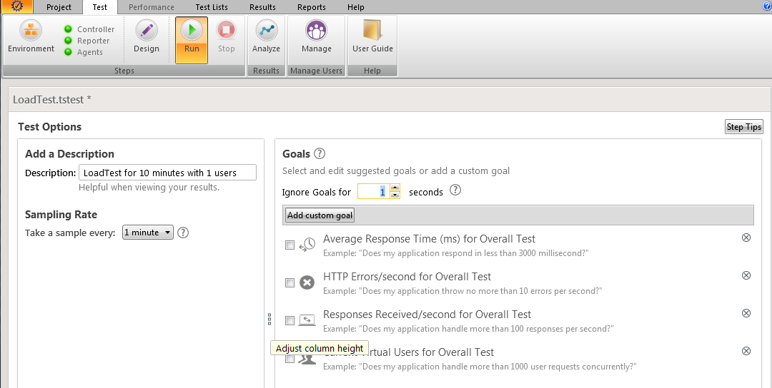
Running Tests
Description
Sampling Rate
How often a snapshot should be made
Goals

Slide 16
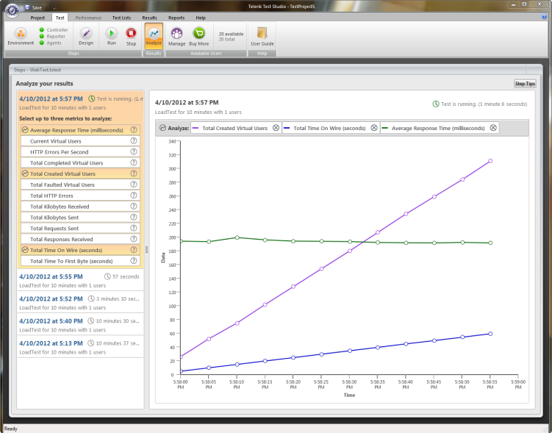
Analyzing Results
All Runs performed
Metrics to analyze
Displaying graph for metric

Slide 17
Load Testing with Test Studio
Demo

Slide 18
Performance, Load Testing, Stress Testing
?
?
?
?
?
Questions?
?
?
?
?
?
?

Slide 19
Exercises
You can practice a performance testing on http://test.telerikacademy.com/

